Slide 1
Street Maps and Scales
Topic: Street Maps and Scales
EQ: How do we read street maps?

Slide 2
Topic: Street Maps and Scales EQ: How do we read street maps?
Most new cars today have a built in GPS. Our phones have multiple apps for directions. But what happens when we need to use an alternate route due to an accident or trusty Google Maps has given us a dodgy route?
We use what those of us born in the 90’s and below call a street directory. Street maps have a grid, coordinate system to help us locate features. We read coordinates by starting with:
The horizontal (across) letters, then the vertical (up and down) letters

Slide 3
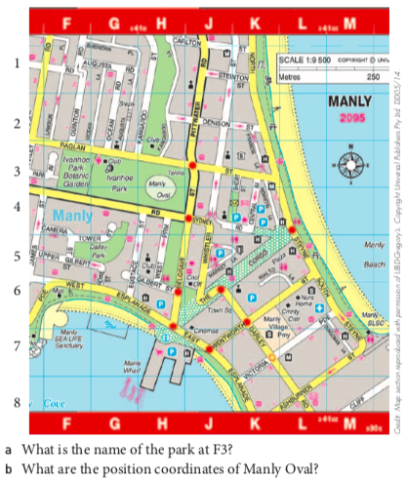

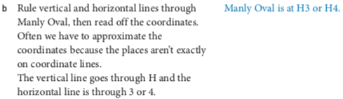
Example

Slide 4
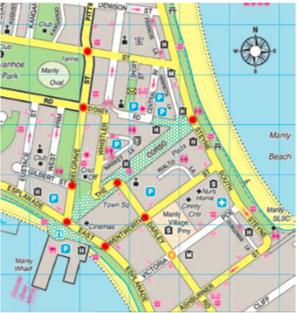
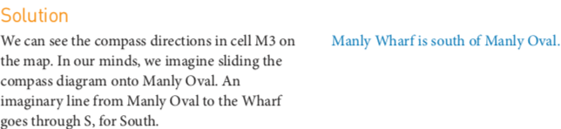
Example

Slide 5
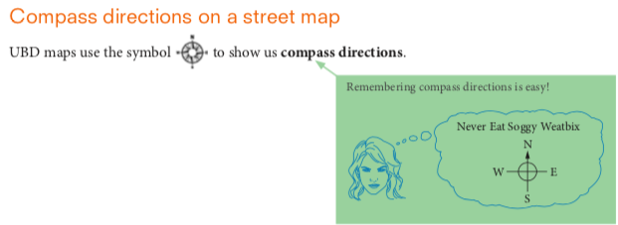
Topic: Street Maps and Scales EQ: How do we read street maps?
Remember:

Slide 6
Your Turn
Complete Exercise 13.02 Worksheet (pg. 325/326 of Nelson 11 Essentials)

Slide 7
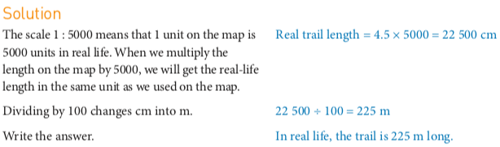
Topic: Street Maps and Scales EQ: How do we read street maps?
Maps are a common feature of every day life. A map’s scale is used to calculate lengths on a map. An example:

Slide 8
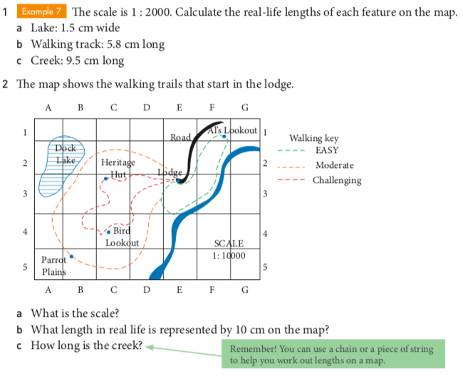
Guided Practice

Slide 9
Your Turn
Working with Scales Worksheet (just the first 2 pages)

Slide 10
Kahoot Time!
https://create.kahoot.it/details/map-work-and-scale-and-compass-directions/dab6010a-938d-401b-b205-776863746592

